Slide 1
Chapter 6: Synchronization Tools

Slide 2
Chapter 6: Synchronization Tools
Background
The Critical-Section Problem
Peterson’s Solution
Hardware Support for Synchronization
Mutex Locks
Semaphores
Monitors
Liveness
Evaluation

Slide 3
Objectives
Describe the critical-section problem and illustrate a race condition
Illustrate hardware solutions to the critical-section problem using memory barriers, compare-and-swap operations, and atomic variables
Demonstrate how mutex locks, semaphores, monitors, and condition variables can be used to solve the critical section problem
Evaluate tools that solve the critical-section problem in low-. Moderate-, and high-contention scenarios

Slide 4
Background
Processes can execute concurrently
  May be interrupted at any time, partially completing execution
Concurrent access to shared data may result in data inconsistency
Maintaining data consistency requires mechanisms to ensure the orderly execution of cooperating processes
Illustration of the problem:
Suppose that we wanted to provide a solution to the consumer-producer problem that fills all the buffers. We can do so by having an integer counter that keeps track of the number of full buffers. Initially, counter is set to 0. It is incremented by the producer after it produces a new buffer and is decremented by the consumer after it consumes a buffer.

Slide 5
Producer
while (true) {
/* produce an item in next produced */
while (counter == BUFFER_SIZE)
; /* do nothing */
buffer[in] = next_produced;
in = (in + 1) % BUFFER_SIZE;
counter++;
}

Slide 6
Consumer
while (true) {
while (counter == 0)
; /* do nothing */
next_consumed = buffer[out];
out = (out + 1) % BUFFER_SIZE;
counter--;
/* consume the item in next consumed */
}

Slide 7
Race Condition
counter++ could be implemented as
register1 = counter
register1 = register1 + 1
counter = register1
counter-- could be implemented as
register2 = counter
register2 = register2 - 1
counter = register2
Consider this execution interleaving with “count = 5” initially:
  S0: producer execute register1 = counter {register1 = 5}
  S1: producer execute register1 = register1 + 1 {register1 = 6}
  S2: consumer execute register2 = counter {register2 = 5}
  S3: consumer execute register2 = register2 – 1 {register2 = 4}
  S4: producer execute counter = register1 {counter = 6 }
  S5: consumer execute counter = register2 {counter = 4}

Slide 8
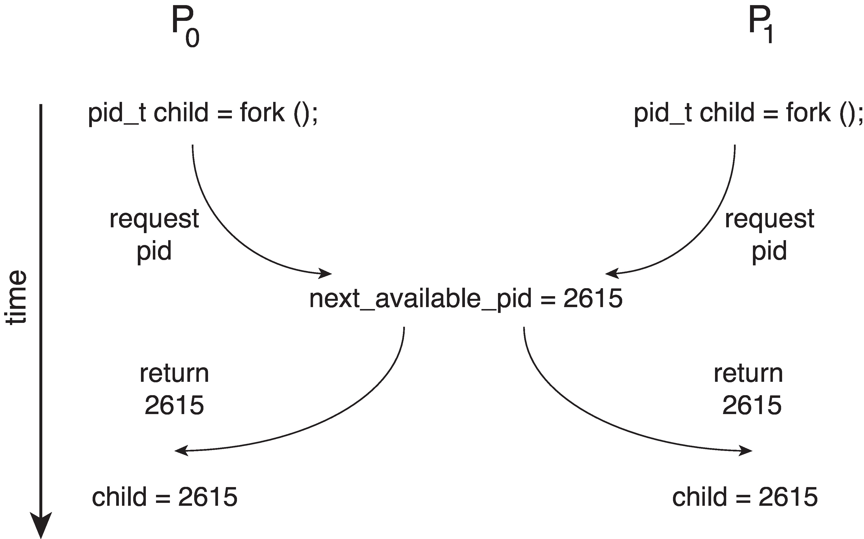
Race Condition
Processes P₀ and P₁ are creating child processs using the fork() system call
Race condition on kernel variable next_available_pid which represents the next available process identifier (pid)
Unless there is mutual exclusion, the same pid could be assigned to two different processes!

Slide 9
Critical Section Problem
Consider system of n processes {p₀, p₁, … p_{n-1}}
Each process has critical section segment of code
  Process may be changing common variables, updating table, writing file, etc
  When one process in critical section, no other may be in its critical section
Critical section problem is to design protocol to solve this
Each process must ask permission to enter critical section in entry section, may follow critical section with exit section, then remainder section

Slide 10

Critical Section
General structure of process P_{i}

Slide 11
Solution to Critical-Section Problem
1. Mutual Exclusion - If process P_{i} is executing in its critical section, then no other processes can be executing in their critical sections
2. Progress - If no process is executing in its critical section and there exist some processes that wish to enter their critical section, then the selection of the processes that will enter the critical section next cannot be postponed indefinitely
3. Bounded Waiting - A bound must exist on the number of times that other processes are allowed to enter their critical sections after a process has made a request to enter its critical section and before that request is granted
  Assume that each process executes at a nonzero speed
  No assumption concerning relative speed of the n processes

Slide 12
Critical-Section Handling in OS
Two approaches depending on if kernel is preemptive or non- preemptive
  Preemptive – allows preemption of process when running in kernel mode
  Non-preemptive – runs until exits kernel mode, blocks, or voluntarily yields CPU
    Essentially free of race conditions in kernel mode

Slide 13
Peterson’s Solution
Not guaranteed to work on modern architectures! (But good algorithmic description of solving the problem)
Two process solution
Assume that the load and store machine-language instructions are atomic; that is, cannot be interrupted
The two processes share two variables:
  int turn;
  boolean flag[2]
The variable turn indicates whose turn it is to enter the critical section
The flag array is used to indicate if a process is ready to enter the critical section. flag[i] = true implies that process P_{i} is ready!

Slide 14
Algorithm for Process P_{i}
while (true){
flag[i] = true;
turn = j;
while (flag[j] && turn = = j)
;
/* critical section */
flag[i] = false;
/* remainder section */
}

Slide 15
Peterson’s Solution (Cont.)
Provable that the three CS requirement are met:
1. Mutual exclusion is preserved
P_{i} enters CS only if:
either flag[j] = false or turn = i
2. Progress requirement is satisfied
3. Bounded-waiting requirement is met

Slide 16
Peterson’s Solution
Although useful for demonstrating an algorithm, Peterson’s Solution is not guaranteed to work on modern architectures.
Understanding why it will not work is also useful for better understanding race conditions.
To improve performance, processors and/or compilers may reorder operations that have no dependencies.
For single-threaded this is ok as the result will always be the same.
For multithreaded the reordering may produce inconsistent or unexpected results!

Slide 17
Peterson’s Solution
Two threads share the data:
boolean flag = false;
int x = 0;
Thread 1 performs
while (!flag)
;
print x
Thread 2 performs
x = 100;
flag = true
What is the expected output?

Slide 18
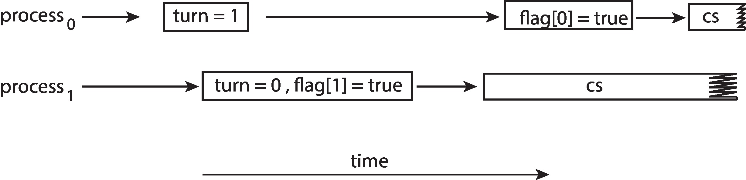
Peterson’s Solution
100 is the expected output.
However, the operations for Thread 2 may be reordered:
flag = true;
x = 100;
If this occurs, the output may be 0!
The effects of instruction reordering in Peterson’s Solution
This allows both processes to be in their critical section at the same time!

Slide 19
Synchronization Hardware
Many systems provide hardware support for implementing the critical section code.
Uniprocessors – could disable interrupts
  Currently running code would execute without preemption
  Generally too inefficient on multiprocessor systems
    Operating systems using this not broadly scalable
We will look at three forms of hardware support:
1. Memory barriers
2. Hardware instructions
3. Atomic variables

Slide 20
Memory Barriers
Memory model are the memory guarantees a computer architecture makes to application programs.
Memory models may be either:
Strongly ordered – where a memory modification of one processor is immediately visible to all other processors.
Weakly ordered – where a memory modification of one processor may not be immediately visible to all other processors.
A memory barrier is an instruction that forces any change in memory to be propagated (made visible) to all other processors.

Slide 21
Memory Barrier
We could add a memory barrier to the following instructions to ensure Thread 1 outputs 100:
Thread 1 now performs
while (!flag)
memory_barrier();
print x
Thread 2 now performs
x = 100;
memory_barrier();
flag = true

Slide 22
Hardware Instructions
Special hardware instructions that allow us to either test-and-modify the content of a word, or two swap the contents of two words atomically (uninterruptibly.)
Test-and-Set instruction
Compare-and-Swap instruction

Slide 23
test_and_set Instruction
Definition:
boolean test_and_set (boolean *target)
{
boolean rv = *target;
*target = true;
return rv:
}
Executed atomically
Returns the original value of passed parameter
Set the new value of passed parameter to true

Slide 24
Solution using test_and_set()
Shared boolean variable lock, initialized to false
Solution:
do {
while (test_and_set(&lock))
; /* do nothing */
/* critical section */
lock = false;
/* remainder section */
} while (true);

Slide 25
compare_and_swap Instruction
Definition:
int compare _and_swap(int *value, int expected, int new_value) {
int temp = *value;
if (*value == expected)
*value = new_value;
return temp;
}
Executed atomically
Returns the original value of passed parameter value
Set the variable value the value of the passed parameter new_value but only if *value == expected is true. That is, the swap takes place only under this condition.

Slide 26
Solution using compare_and_swap
Shared integer lock initialized to 0;
Solution:
while (true){
while (compare_and_swap(&lock, 0, 1) != 0)
; /* do nothing */
/* critical section */
lock = 0;
/* remainder section */
}

Slide 27
Bounded-waiting Mutual Exclusion with compare-and-swap
while (true) {
waiting[i] = true;
key = 1;
while (waiting[i] && key == 1)
key = compare_and_swap(&lock,0,1);
waiting[i] = false;
/* critical section */
j = (i + 1) % n;
while ((j != i) && !waiting[j])
j = (j + 1) % n;
if (j == i)
lock = 0;
else
waiting[j] = false;
/* remainder section */
}

Slide 28
Atomic Variables
Typically, instructions such as compare-and-swap are used as building blocks for other synchronization tools.
One tool is an atomic variable that provides atomic (uninterruptible) updates on basic data types such as integers and booleans.
For example, the increment() operation on the atomic variable sequence ensures sequence is incremented without interruption:
increment(&sequence);

Slide 29
Atomic Variables
The increment() function can be implemented as follows:
void increment(atomic_int *v)
{
int temp;
do {
temp = *v;
}
while (temp != (compare_and_swap(v,temp,temp+1));
}

Slide 30
Mutex Locks
Previous solutions are complicated and generally inaccessible to application programmers
OS designers build software tools to solve critical section problem
Simplest is mutex lock
Protect a critical section by first acquire() a lock then release() the lock
  Boolean variable indicating if lock is available or not
Calls to acquire() and release() must be atomic
  Usually implemented via hardware atomic instructions such as compare-and-swap.
But this solution requires busy waiting
  This lock therefore called a spinlock

Slide 31
Solution to Critical-section Problem Using Locks
while (true) {
acquire lock
critical section
release lock
remainder section
}

Slide 32
Mutex Lock Definitions
acquire() {
while (!available)
; /* busy wait */
available = false;;
}
release() {
available = true;
}
These two functions must be implemented atomically.
Both test-and-set and compare-and-swap can be
used to implement these functions.

Slide 33
Semaphore
Synchronization tool that provides more sophisticated ways (than Mutex locks) for process to synchronize their activities.
Semaphore S – integer variable
Can only be accessed via two indivisible (atomic) operations
  wait() and signal()
    (Originally called P() and V())
Definition of the wait() operation
  wait(S) {
  while (S <= 0)
  ; // busy wait
  S--;
  }
Definition of the signal() operation
  signal(S) {
  S++;
  }

Slide 34
Semaphore Usage
Counting semaphore – integer value can range over an unrestricted domain
Binary semaphore – integer value can range only between 0 and 1
  Same as a mutex lock
Can solve various synchronization problems
Consider P₁ and P₂ that require S₁ to happen before S₂
Create a semaphore “synch” initialized to 0
  P1:
  S₁;
  signal(synch);
  P2:
  wait(synch);
  S₂;
Can implement a counting semaphore S as a binary semaphore

Slide 35
Semaphore Implementation
Must guarantee that no two processes can execute the wait() and signal() on the same semaphore at the same time
Thus, the implementation becomes the critical section problem where the wait and signal code are placed in the critical section
  Could now have busy waiting in critical section implementation
    But implementation code is short
    Little busy waiting if critical section rarely occupied
Note that applications may spend lots of time in critical sections and therefore this is not a good solution

Slide 36
Semaphore Implementation with no Busy waiting
With each semaphore there is an associated waiting queue
Each entry in a waiting queue has two data items:
  value (of type integer)
  pointer to next record in the list
Two operations:
  block – place the process invoking the operation on the appropriate waiting queue
  wakeup – remove one of processes in the waiting queue and place it in the ready queue
typedef struct {
int value;
struct process *list;
} semaphore;

Slide 37
Implementation with no Busy waiting (Cont.)
wait(semaphore *S) {
S->value--;
if (S->value < 0) {
add this process to S->list;
block();
}
}
signal(semaphore *S) {
S->value++;
if (S->value <= 0) {
remove a process P from S->list;
wakeup(P);
}
}

Slide 38
Problems with Semaphores
Incorrect use of semaphore operations:
  signal (mutex) …. wait (mutex)
  wait (mutex) … wait (mutex)
  Omitting of wait (mutex) and/or signal (mutex)
These – and others – are examples of what can occur when sempahores and other synchronization tools are used incorrectly.

Slide 39
Monitors
A high-level abstraction that provides a convenient and effective mechanism for process synchronization
Abstract data type, internal variables only accessible by code within the procedure
Only one process may be active within the monitor at a time
Pseudocode syntax of a monitor:
    monitor monitor-name
    {
    // shared variable declarations
    function P1 (…) { …. }
    function P2 (…) { …. }
    function Pn (…) {……}
    initialization code (…) { … }
    }

Slide 40
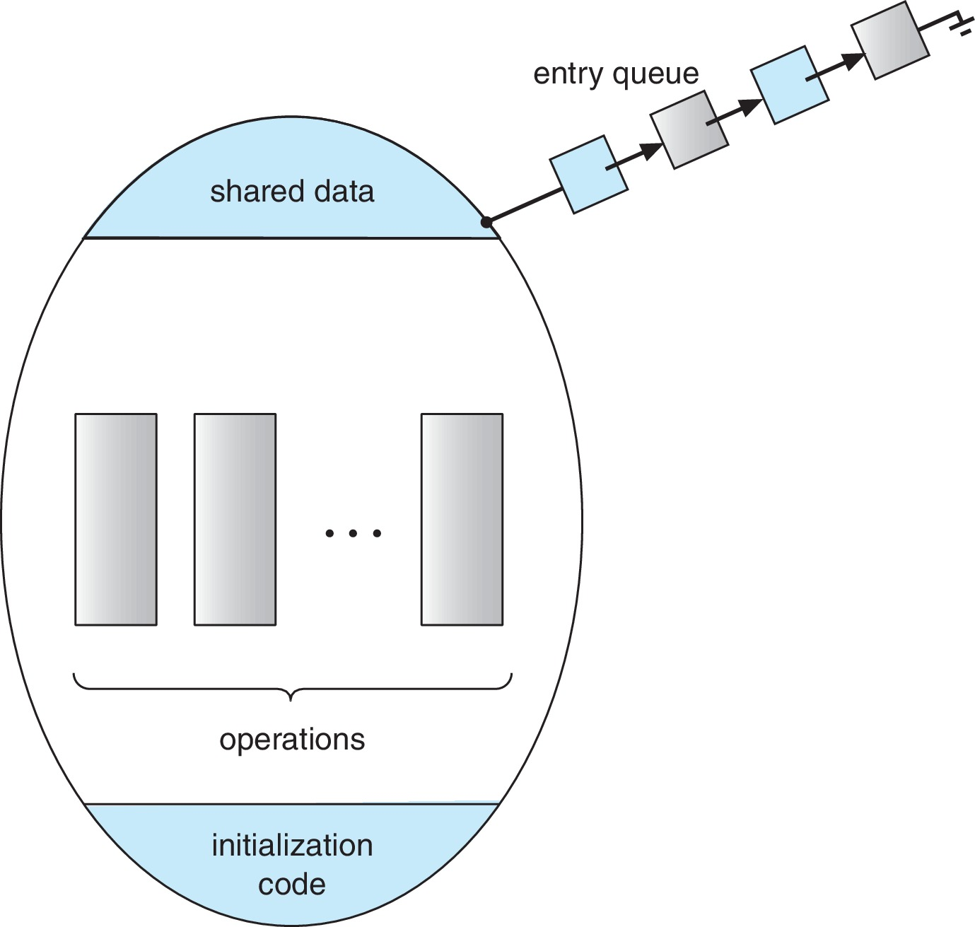
Schematic view of a Monitor

Slide 41
Condition Variables
condition x, y;
Two operations are allowed on a condition variable:
  x.wait() – a process that invokes the operation is suspended until x.signal()
  x.signal() – resumes one of processes (if any) that invoked x.wait()
    If no x.wait() on the variable, then it has no effect on the variable

Slide 42
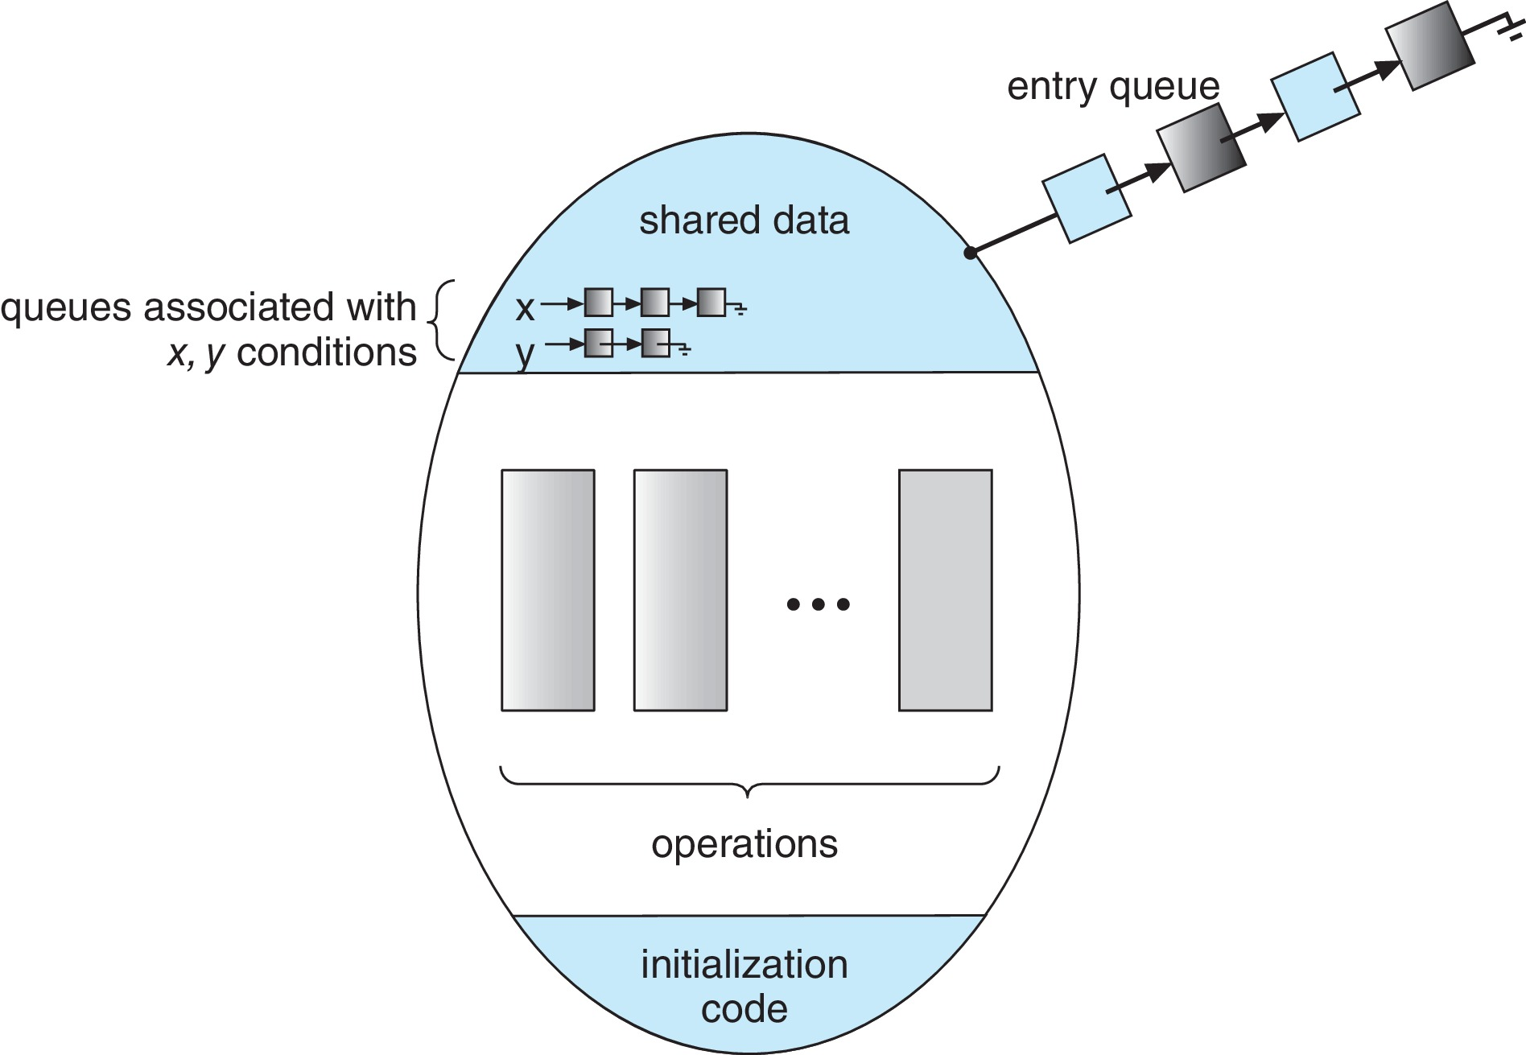
Monitor with Condition Variables

Slide 43
Condition Variables Choices
If process P invokes x.signal(), and process Q is suspended in x.wait(), what should happen next?
  Both Q and P cannot execute in paralel. If Q is resumed, then P must wait
Options include
  Signal and wait – P waits until Q either leaves the monitor or it waits for another condition
  Signal and continue – Q waits until P either leaves the monitor or it waits for another condition
  Both have pros and cons – language implementer can decide
  Monitors implemented in Concurrent Pascal compromise
    P executing signal immediately leaves the monitor, Q is resumed
  Implemented in other languages including Mesa, C#, Java

Slide 44
Monitor Implementation Using Semaphores
Variables
semaphore mutex; // (initially = 1)
semaphore next; // (initially = 0)
int next_count = 0;
Each function F will be replaced by
wait(mutex);
…
body of F;
…
if (next_count > 0)
signal(next)
else
signal(mutex);
Mutual exclusion within a monitor is ensured

Slide 45
Monitor Implementation – Condition Variables
For each condition variable x, we have:
semaphore x_sem; // (initially = 0)
int x_count = 0;
The operation x.wait() can be implemented as:
x_count++;
if (next_count > 0)
signal(next);
else
signal(mutex);
wait(x_sem);
x_count--;

Slide 46
Monitor Implementation (Cont.)
The operation x.signal() can be implemented as:
if (x_count > 0) {
next_count++;
signal(x_sem);
wait(next);
next_count--;
}

Slide 47
Resuming Processes within a Monitor
If several processes queued on condition variable x, and x.signal() is executed, which process should be resumed?
FCFS frequently not adequate
conditional-wait construct of the form x.wait(c)
  Where c is priority number
  Process with lowest number (highest priority) is scheduled next

Slide 48
Single Resource allocation
Allocate a single resource among competing processes using priority numbers that specify the maximum time a process plans to use the resource
R.acquire(t);
...
access the resurce;
...
R.release;
Where R is an instance of type ResourceAllocator

Slide 49
A Monitor to Allocate Single Resource
monitor ResourceAllocator
{
boolean busy;
condition x;
void acquire(int time) {
if (busy)
x.wait(time);
busy = true;
}
void release() {
busy = FALSE;
x.signal();
}
initialization code() {
busy = false;
}
}

Slide 50
Liveness
Processes may have to wait indefinitely while trying to acquire a synchronization tool such as a mutex lock or semaphore.
Waiting indefinitely violates the progress and bounded-waiting criteria discussed at the beginning of this chapter.
Liveness refers to a set of properties that a system must satisfy to ensure processes make progress.
Indefinite waiting is an example of a liveness failure.

Slide 51
Liveness
Deadlock – two or more processes are waiting indefinitely for an event that can be caused by only one of the waiting processes
Let S and Q be two semaphores initialized to 1
P₀ P₁
wait(S); wait(Q);
wait(Q); wait(S);
... ...
signal(S); signal(Q);
signal(Q); signal(S);
Consider if P₀ executes wait(S) and P₁ wait(Q). When P₀ executes wait(Q), it must wait until P₁ executes signal(Q)
However, P₁ is waiting until P₀ execute signal(S).
Since these signal() operations will never be executed, P₀ and P₁ are deadlocked.

Slide 52
Liveness
Other forms of deadlock:
Starvation – indefinite blocking
  A process may never be removed from the semaphore queue in which it is suspended
Priority Inversion – Scheduling problem when lower-priority process holds a lock needed by higher-priority process
Solved via priority-inheritance protocol

Slide 53
Priority Inheritance Protocol
Consider the scenario with three processes P1, P2, and P3. P1 has the highest priority, P2 the next highest, and P3 the lowest. Assume a resouce P3 is assigned a resource R that P1 wants. Thus, P1 must wait for P3 to finish using the resource. However, P2 becomes runnable and preempts P3. What has happened is that P2 - a process with a lower priority than P1 - has indirectly prevented P3 from gaining access to the resource.
To prevent this from occurring, a priority inheritance protocol is used. This simply allows the priority of the highest thread waiting to access a shared resource to be assigned to the thread currently using the resource. Thus, the current owner of the resource is assigned the priority of the highest priority thread wishing to acquire the resource.

Slide 54
End of Chapter 6

